Slide 1
Ice Cream Trucks
MTA Turnstile Exploratory Data Analysis

Slide 2
Back story
Ice cream Trucks company want to increase the sales of the ice cream
trucks during the four months(May, June, July, August) of the summer period in 2018, and this will be done by identifying the busiest stations and determining the best located for the ice cream trucks, So we analyzed the stations data in New York City

Slide 3
Tools
Terminology
Libraries
Jupter Notebook, Python
Numpy, Matplotlib, Pandas, SqlAlshema, Seaborn

Slide 4
Workflow
Read Data set MTA from The link
Define heist traffic station
Step 1
Step 2
Step 3
Step 4
Clean data set
Connect data set with SQLite

Slide 5
Clean Data set
01
Check of NAN
Drop duplicates
02
Minimum and Maximum of numerical values
Outlies
03
04

Slide 6
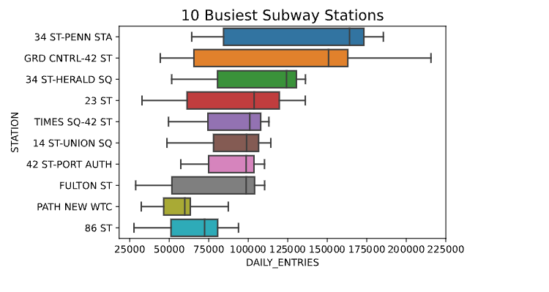
Heist Traffic Station with Daily_Entries

Slide 7
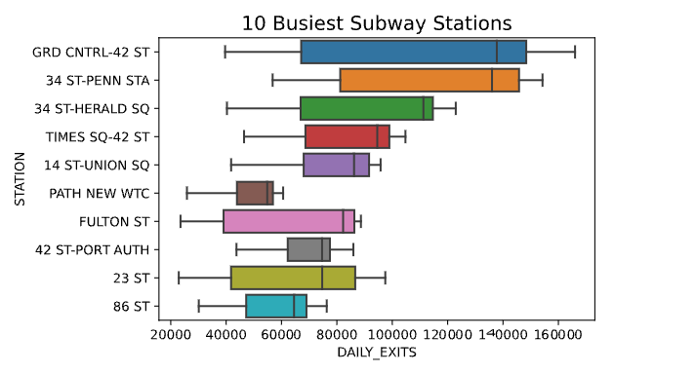
Heist Traffic Station with Daily_Exits

Slide 8
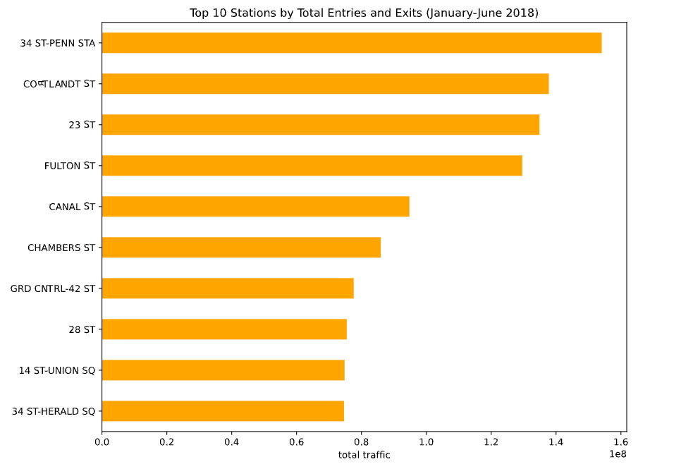
Heist Traffic Station

Slide 9
Conclusion
It is preferred to locate Ice Cream trucks at the top 10 crowded stations and
provide the most famous flavors in New York
Strawberry
Chocolate
Candy
Candy
Pistachio

Slide 10
Future Work
As a result, the trucks will be located to the 10 busiest stations to increase sales of the
Ice Cream Trucks can be set based on when the temperatures are rising and also during the rush hours
80%
65%
75%
90%

Slide 11
Thank you
By Shahad Aati

